Slide 1
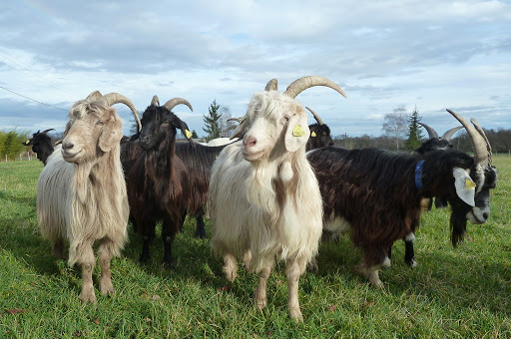
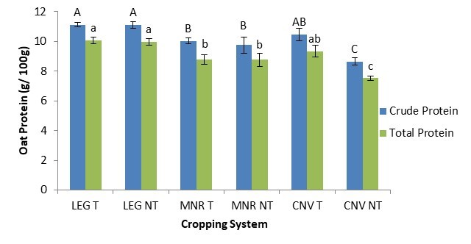
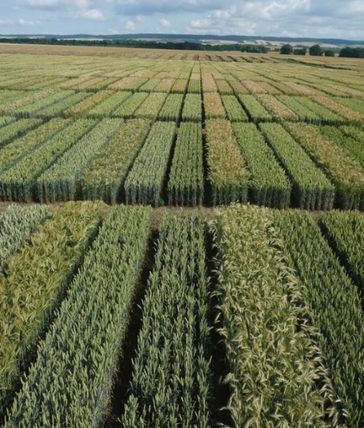
C7041 Experimental Design and Analysis
Ed Harris

Slide 2
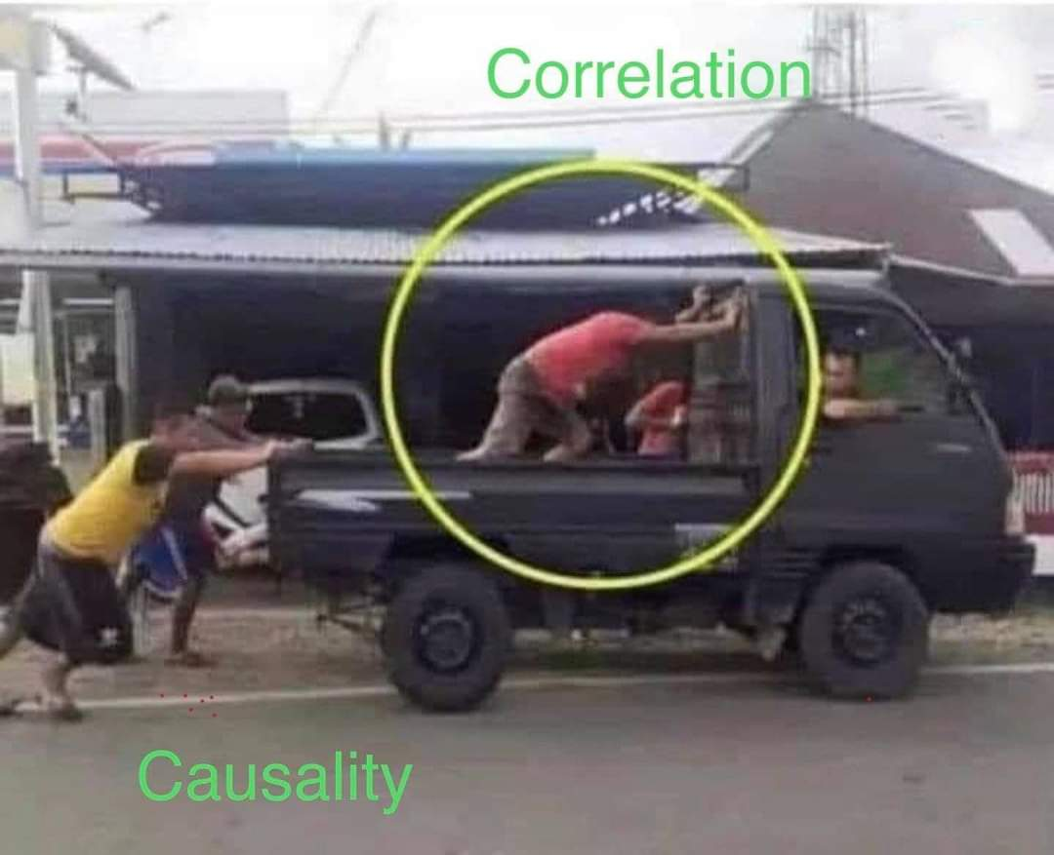
1.16 Correlation
http://tylervigen.com/spurious-correlations

Slide 3
Two variables: Which test?
 |  | Explanatory variable
 |  | Categorical | Numerical
Response variable | Categorical | Contingency analysis | Logistic regression Survival analysis
 | Numerical | t-test | Regression
 |  | Analysis of variance | Correlation

Slide 4
Scatter plot
Tattersall et al. (2004) Journal of Experimental Biology 207:579-585

Slide 5
Correlation: r
r is called the "correlation coefficient"
Describes the relationship between two numerical variables
Parameter: ρ (rho) Estimate: r
-1 < ρ < 1

Slide 6
Correlation: r

Slide 7
Correlation: r
https://shiney.zoology.ubc.ca/whitlock/Guessing_correlation/

Slide 8
Correlation assumes...
Random sample
X is Gaussian distributed with equal variance for all values of Y
Y is Gaussian distributed with equal variance for all values of X

Slide 9
Coefficient of determination
_{r}2
Describes the proportion of variation in one variable that can be predicted from the other variable

Slide 10
Correlation coefficient
r = Covariance(X, Y )
Var(X ) Var(Y )

Slide 11
Covariance

Slide 12
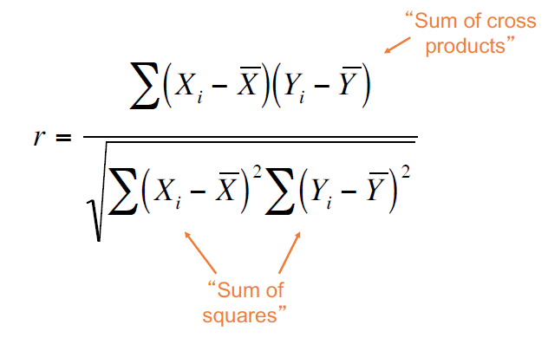
Estimating the correlation coefficient

Slide 13
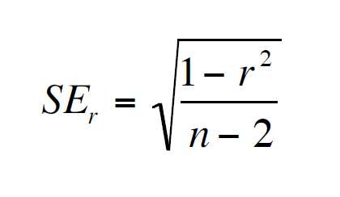
Standard error of r

Slide 14
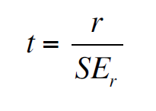
If ρ = 0,...
r is normally distributed with mean 0
with df = n -2

Slide 15
Godwit arrival time data
Black-tailed godwits are migratory and socially monogamous.
Are the males and females in a pair correlated in their arrival dates after migration?
Limosa limosa
Gunnarsson, T. G., J. A. Gill, T. Sigurbjörnsson, and W. J. Sutherland. 2004. Arrival synchrony in migratory birds. Nature 431: 646.

Slide 16
Godwit arrival time data
(units: days after March 31)
Female arrival date (X) | Male arrival date (Y)
24 | 22
36 | 35
35 | 35
35 | 44
38 | 46
50 | 50
55 | 55
56 | 56
57 | 56
69 | 59
$Σ$X= 455 | $Σ$Y= 458

Slide 17
Godwit arrival time data
Gunnarsson, T. G., J. A. Gill, T. Sigurbjörnsson, and W. J. Sutherland. 2004. Arrival synchrony in migratory birds. Nature 431: 646.

Slide 18
Hypotheses
H₀: Arrival date of female and arrival date of male are not related (ρ = 0).
H_{A} : Arrival date of female and arrival date of male are correlated (ρ ≠ 0).

Slide 19
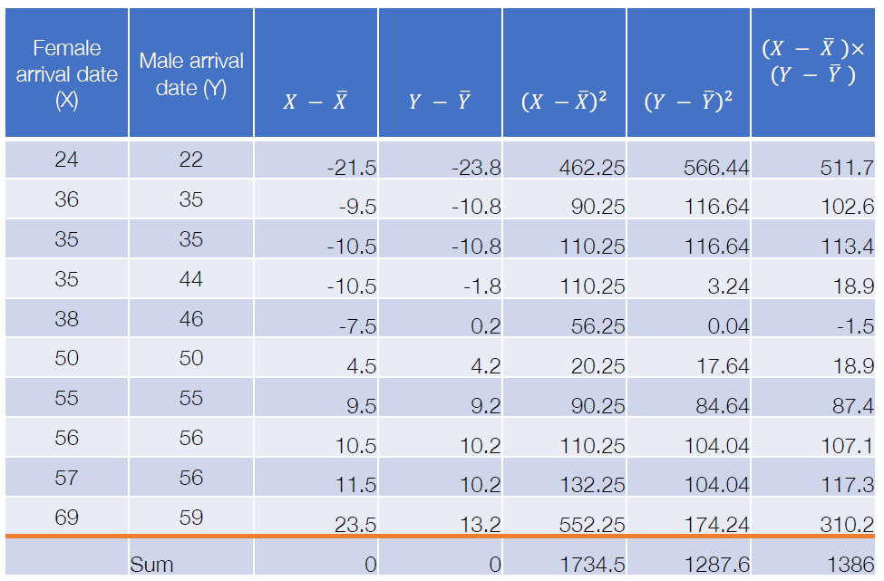
Godwit arrival time data
(units: days after March 31)

Slide 20
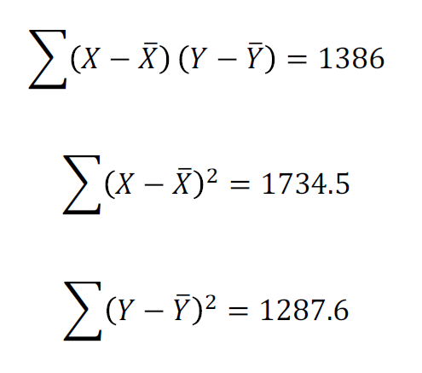
Finding r

Slide 21
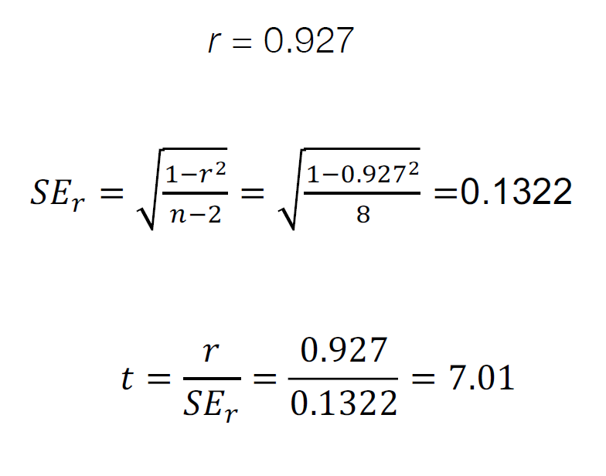
Finding SE and t for r

Slide 22
Finding SE and t for r
df = n – 2 = 10 – 2 = 8
t=7.01 is greater than t_{0.05(2), 8} = 2.31, so we can reject the null hypothesis and say that female and male arrival times are correlated

Slide 23
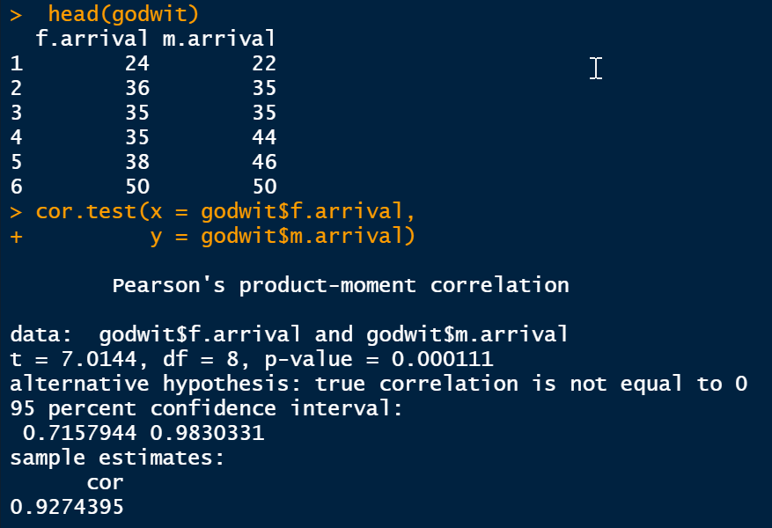
Testing r in R
(see what I did there?)

Slide 24
Spearman's rank correlation
An alternative to correlation that does not make so many assumptions

Slide 25
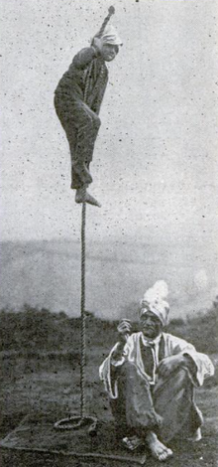
Example: Spearman's r_{s}
VERSIONS:
Boy climbs up rope, climbs down again
Boy climbs up rope, seems to vanish, re-appears at top, climbs down again
Boy climbs up rope, seems to vanish at top
Boy climbs up rope, vanishes at top, reappears somewhere the audience was not looking
Boy climbs up rope, vanishes at top, reappears in a place which has been in full view

Slide 26
Example: Spearman's r_{s}
Hypotheses
H₀: The difficulty of the described trick is not correlated with the time elapsed since it was observed.
H_{A}: The difficulty of the described trick is correlated with the time elapsed since it was observed.

Slide 27
Example: Spearman's r_{s}
r_{s} = 0.712
P < 0.05

Slide 28
“Attenuation“ in correlation
The estimated correlation will be lower if X or Y are estimated with error
X and Y estimated with measurement error
Y estimated with measurement error
Real correlation

Slide 29
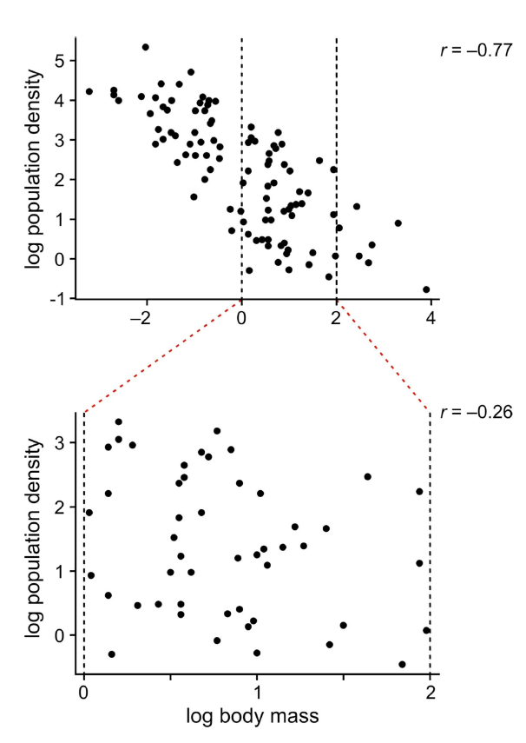
Correlation depends on range

Slide 30
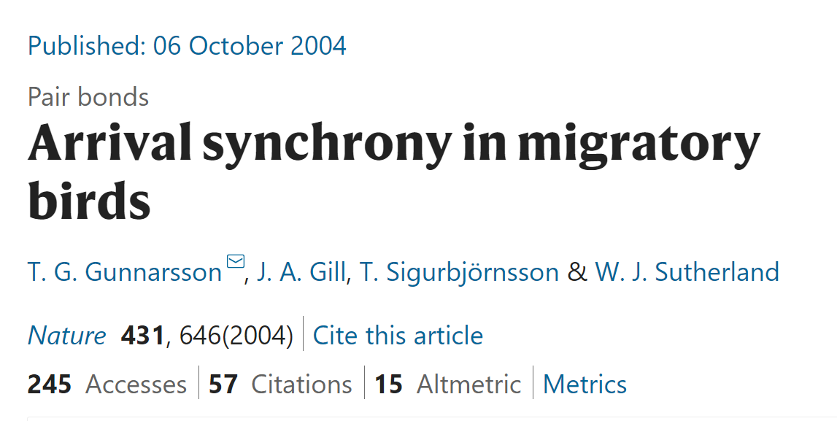
Suggested reading
Gunnarsson, T.G., Gill, J.A., Sigurbjörnsson, T., Sutherland, W.J., 2004. Arrival synchrony in migratory birds. Nature 431, 646–646. https://doi.org/10.1038/431646a

