Slide 1
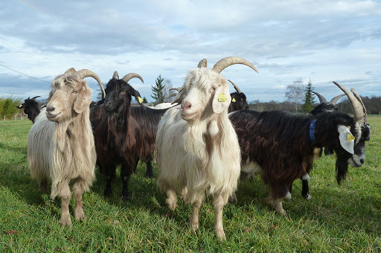
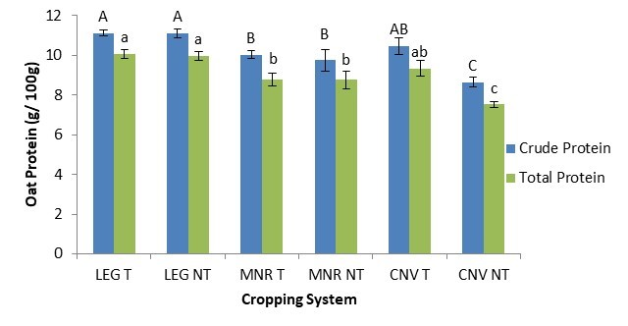
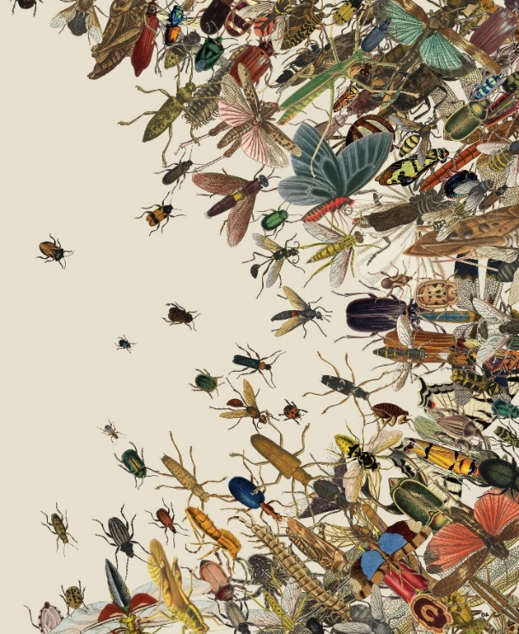
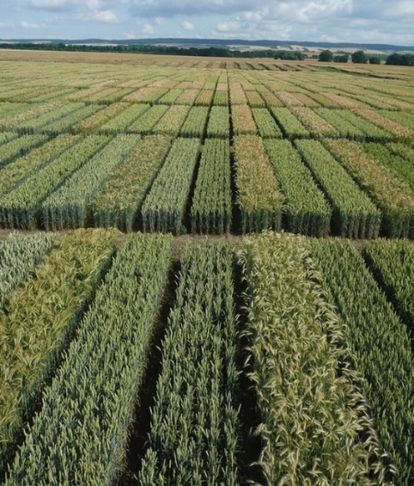
C7041 Experimental Design and Analysis
Ed Harris

Slide 2
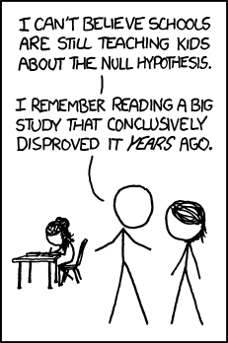
1.06 Hypothesis testing

Slide 3
Hypothesis testing
Hypothesis testing asks how unusual it is to get data that differ from the null hypothesis.
If the data would be quite unlikely under H₀, we reject H₀.

Slide 4
Hypothesis testing

Slide 5
Hypothesis testing
Hypotheses are about populations, but are tested with data from samples
Hypothesis testing usually assumes that sampling is random.

Slide 6
Hypothesis testing
Null hypothesis: a specific statement about a population parameter made for the purposes of
argument.
Alternate hypothesis: represents all other possible parameter values except that stated in the null hypothesis.

Slide 7
The null hypothesis is usually the simplest statement The alternative hypothesis is usually the statement of greatest interest
Hypothesis testing

Slide 8
Hypothesis testing
A good null hypothesis would be interesting if proven wrong.
A null hypothesis is specific; an alternate hypothesis is not.

Slide 9
Test Statistic
A number calculated to represent the match between a set of data and the null hypothesis
Can be compared to a general distribution to infer probability

Slide 10
Test Statistic
Possible outcomes from samples under null hypothesis

Slide 11
Test Statistic
A test statistic summarizes the match between the data and the null hypothesis

Slide 12
P-value

Slide 13
P-value
A P-value is the probability of getting the data, or something as or more unusual, if the null hypothesis were true.

Slide 14
How to find P-values
Simulation
Parametric tests
Permutation

Slide 15
Hypothesis testing: an example
Does a red shirt help win wrestling?

Slide 16
The experiment and the results
Animals use red as a sign of aggression
Does red influence the outcome of wrestling, taekwondo, and boxing?
16 of 20 rounds had more red-shirted than blue-shirted winners in these sports in the 2004 Olympics
Shirt color was randomly assigned
Hill, RA, and RA Burton 2005. Red enhances human performance in contests Nature 435:293.

Slide 17
Stating the hypotheses
H₀: Red- and blue-shirted athletes are equally likely to win (proportion = 0.5).
H_{A}: Red- and blue-shirted athletes are not equally likely to win (proportion ≠ 0.5).

Slide 18
Estimating the value
16 of 20 is a proportion of proportion = 0.8
This is a discrepancy of 0.3 from the proportion proposed by the null hypothesis, proportion = 0.5

Slide 19
Estimating the value
Is this discrepancy by chance alone?:
Estimating the probability of such an extreme result
The null distribution for a test statistic is the probability distribution of alternative outcomes when a random sample is taken from a population corresponding to the null expectation.

Slide 20
The null distribution of the
sample number of red wins

Slide 21
Calculating the P-value from the null distribution
The P-value is calculated as
P = 2 × [Pr(16) + Pr(17) + Pr(18) + Pr(19) + Pr(20)] = 0.012.

Slide 22
Statistical significance
The significance level, α, is a probability used as a criterion for rejecting the null hypothesis.
If the P-value for a test is less than or equal to α, then the null hypothesis is rejected.

Slide 23
Statistical significance
α is often 0.05

Slide 24
Statistical significance
Significance for the red shirt example
P = 0.012
P < α, so we can reject the null hypothesis
Athletes in red shirts were more likely to win

Slide 25
Larger samples give more information
A larger sample will tend to give and estimate with a smaller confidence interval
A larger sample will give more power to reject a false null hypothesis

Slide 26
Sample R code for doing this simulation
(Note: This is not necessarily the most efficient code for this)
binarySample <- function(n, prob){
results = rep(NA,n)
for(i in 1:n){
if(runif(1) < prob) results[i] = "red"
else
results[i] = "blue"
}
length(which(results=="red"))
}
numreps <- 10000
resultsDF <- data.frame(numberRedWins = replicate(numreps,
binarySample(20, .5)))

Slide 27
Hypothesis testing: another example
Do dogs resemble their owners?

Slide 28
Common wisdom holds that dogs resemble their owners. Is this true?
41 dog owners approached in parks; photos taken of dog and owner separately
Photo of owner and dog, along with another photo of dog, shown to students to match
Roy, M.M., & Christenfeld, N.J.S. (2004). Do dogs resemble their owners? Psychological Science, 15, 361–363

Slide 29
Hypotheses
H₀: The proportion of correct matches is proportion = 0.5.
H_{A}: The proportion of correct matches is different from proportion = 0.5.

Slide 30
Data
Of 41 matches:
23 were correct
18 were incorrect

Slide 31
Estimating the proportion

Slide 32
Null distribution for dog/owner resemblance

Slide 33
The P-value:
P = 0.53
We do not reject the null hypothesis that dogs do not resemble their owners.

Slide 34
Jargon

Slide 35
Significance level
The acceptable probability of rejecting a true null hypothesis
Called α
For many purposes, α = 0.05 is acceptable.
α is somewhat arbitrarily chosen by researchers.

Slide 36
Type I error
Rejecting a true null hypothesis
Probability of Type I error is α
(the significance level)

Slide 37
Type II error
Not rejecting a false null hypothesis
The probability of a Type II error is β.
The smaller β, the more power a test has.

Slide 38
Power
The ability of a test to reject a false null hypothesis
Power = 1- β

Slide 39
Power
Power increases with more information (i.e. with larger sample size)

Slide 40
Power
One- and two-tailed tests
Most tests are two-tailed tests.
This means that a deviation in either direction would reject the null hypothesis.
Normally α is divided into α / 2 on one side and α / 2 on the other.

Slide 41
Power
2.5%
2.5%
Test statistic

Slide 42
One-tailed tests
Only used when the other tail is nonsensical
For example, comparing grades on a multiple choice test to that expected by random guessing

Slide 43
Critical value
The value of a test statistic beyond which the null hypothesis can be rejected

Slide 44
“Statistically significant”
We never “accept the null hypothesis”
P < α
We can “reject the null hypothesis”

Slide 45
Compare 2 samples
Artwork by @allison_horst https://github.com/allisonhorst/stats-illustrations

Slide 46
Compare 2 samples
Artwork by @allison_horst https://github.com/allisonhorst/stats-illustrations

Slide 47
Compare 2 samples
Artwork by @allison_horst https://github.com/allisonhorst/stats-illustrations

Slide 48
Compare 2 samples
Artwork by @allison_horst https://github.com/allisonhorst/stats-illustrations

Slide 49
Compare 2 samples
Artwork by @allison_horst https://github.com/allisonhorst/stats-illustrations

Slide 50
Compare 2 samples
Artwork by @allison_horst https://github.com/allisonhorst/stats-illustrations

Slide 51
Compare 2 samples
Artwork by @allison_horst https://github.com/allisonhorst/stats-illustrations

Slide 52
Compare 2 samples
Artwork by @allison_horst https://github.com/allisonhorst/stats-illustrations

Slide 53
Compare 2 samples
Artwork by @allison_horst https://github.com/allisonhorst/stats-illustrations

Slide 54
Statistical significance ≠
Biological importance

Slide 56
Correlation does not automatically imply causation

Slide 57
Correlation does not automatically imply causation
Life expectancy by country:
An unmeasured variable that may be the cause of both X and Y
Observations vs.
Experiments

Slide 58
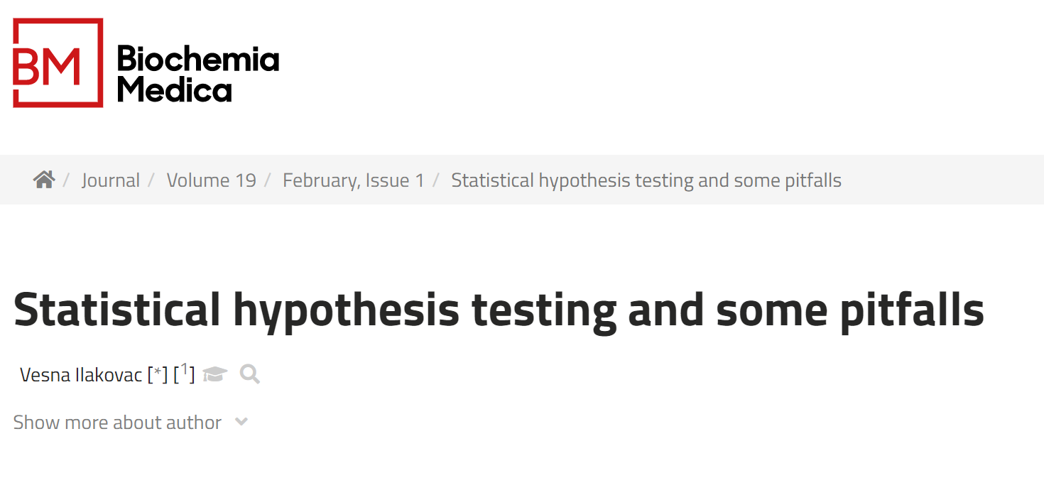
Suggested reading
Ilakovac, V., 2009. Statistical hypothesis testing and some pitfalls. Biochem Med 19, 10–16.

