Slide 1
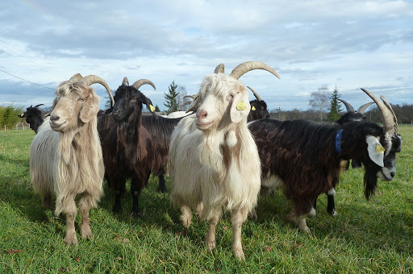
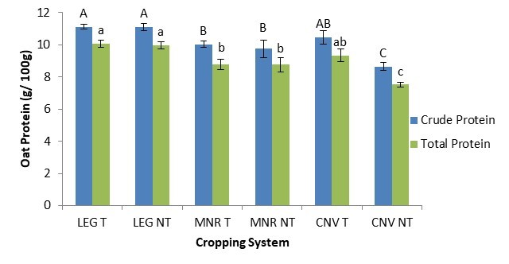
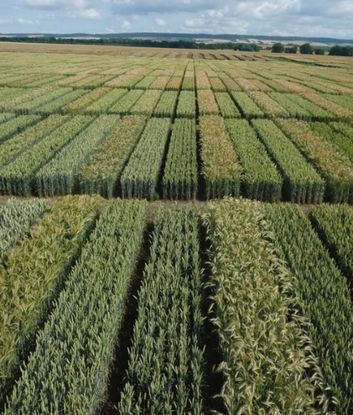
C7041 Experimental Design and Analysis
Ed Harris

Slide 2
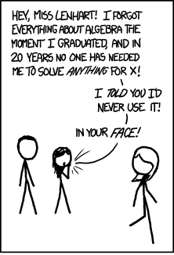
1.01 Intro to stats and sampling
“A refresher on things you may have forgotten or never learned”

Slide 3
The history of statistics has its roots in biology and agriculture

Slide 4
Francis Galton
Inventor of fingerprints
Heredity of quantitative traits
Regression
Correlation

Slide 5
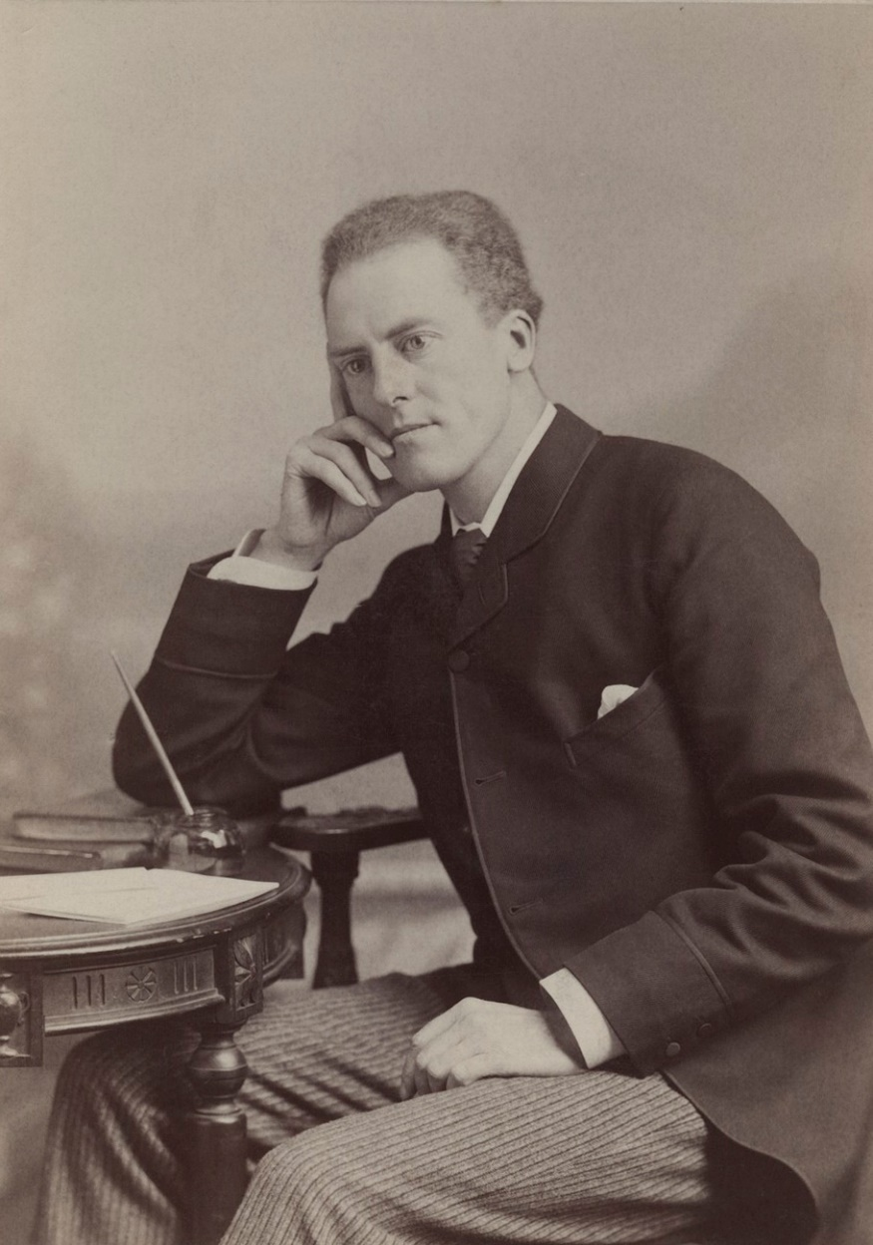
Karl Pearson
Polymath
Studied genetics
Correlation coefficient
χ² test
Standard deviation

Slide 6
The Genetical Theory
of Natural Selection
Founder of population genetics
Analysis of variance
likelihood
P-value
randomized experiments
multiple regression
Rothamsted Station statistics
etc., etc., etc.
Ronald (R.A.) Fisher

Slide 7
What is statistics?
Statistics: "a quantitative technology for empirical science; it is a logic and methodology for the measurement of uncertainty and for an examination of that uncertainty."
The key word here is "uncertainty." Statistics become necessary when observations are variable.

Slide 8
Goals of statistics
Estimate the values of important parameters
Test hypotheses about those parameters
Statistics is also about good scientific practice

Slide 9
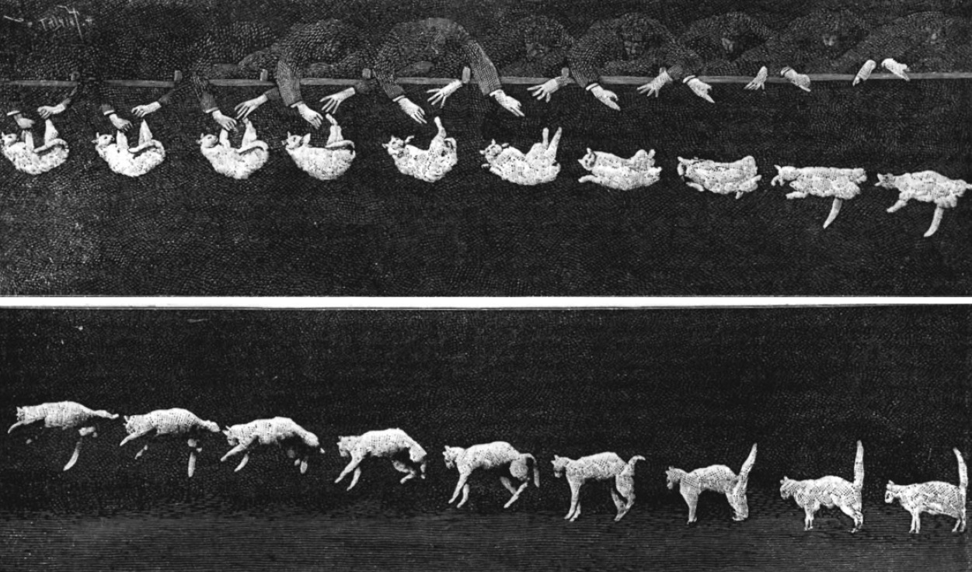
Feline High-Rise Syndrome (FHRS)
The injuries associated with a cat falling out of a window

Slide 10
"The diagnosis of high-rise syndrome is not difficult. Typically, the cat is found outdoors, several stories below, and a nearby window or patio door is open."

Slide 11
High falls show lower injury rates
Whitney and Mehloff, 1987. Journal of the American Veterinary Medicine Association

Slide 12
Why?
Cats have high surface-to-volume ratios
Cats have excellent vestibular systems
Cats reach terminal velocity quickly, relax, and therefore absorb impact better
Cats land on their limbs and absorb shock through soft tissue
Jared Diamond, Nature 1988

Slide 13
Or not…

Slide 14
A sample of convenience is a collection of individuals that happen to be available at the time.

Slide 15
A newer study reports more injuries with longer falls
Vnuk et al. 2004. Feline high-rise syndrome: 119 cases (1998-2001). J. Fel. Med. Surg. 6:305-312.

Slide 16
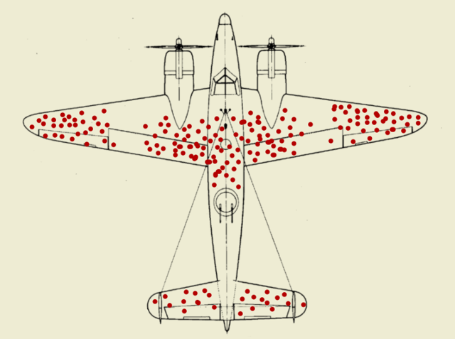
Bullet hole misconception

Slide 17
Variables
Variables are characteristics measured on individuals drawn from a population under study.
Data are measurements of one or more variables made on a collection of individuals.

Slide 18
Explanatory and response variables
We try to predict or explain a response variable from an explanatory variable
alternative terminology:
dependent variable and independent variable

Slide 19
Mortality on the Titanic, as predicted by gender

Slide 20
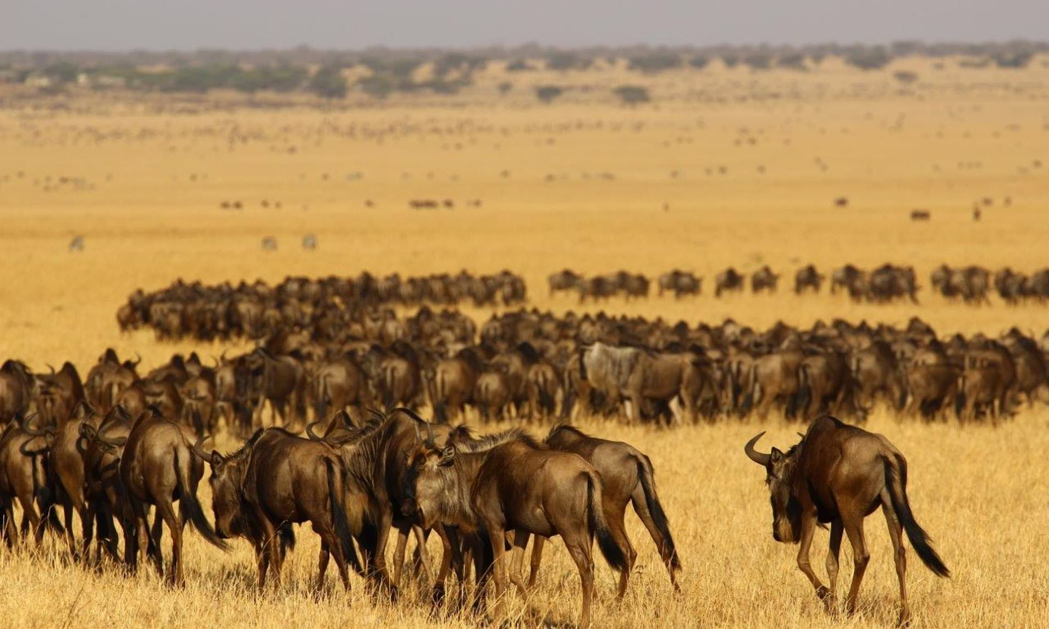
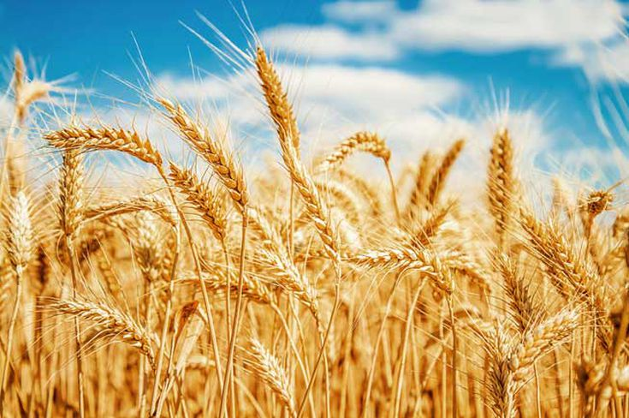
Populations and samples
Population
Population
Sample
Sample

Slide 21
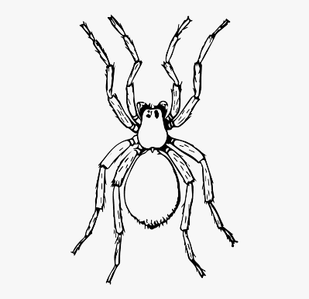
A population of spiders

Slide 22
4 random samples of n=5 spiders

Slide 23
Populations <-> Parameters
Samples <-> Estimates

Slide 24
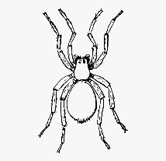
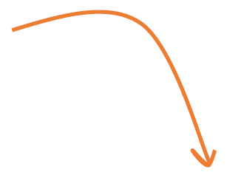
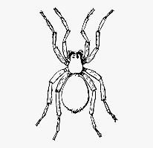
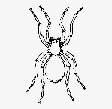
A biased sample

Slide 25
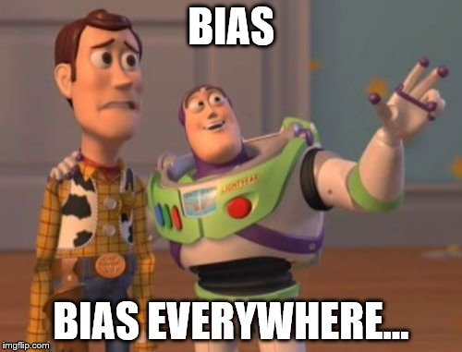
Bias is a systematic discrepancy between estimates and the true population characteristic.

Slide 26
Relatable example
The 1936 US presidential election
vs.
Alf Landon
Republican
Franklin Roosevelt
Democrat

Slide 27
1936 Literary Digest Poll
2.4 million respondents
Based on questionnaires mailed to 10 million people, chosen from telephone books and club lists
Predicted Landon wins: Landen 57% over Roosevelt 43%

Slide 28
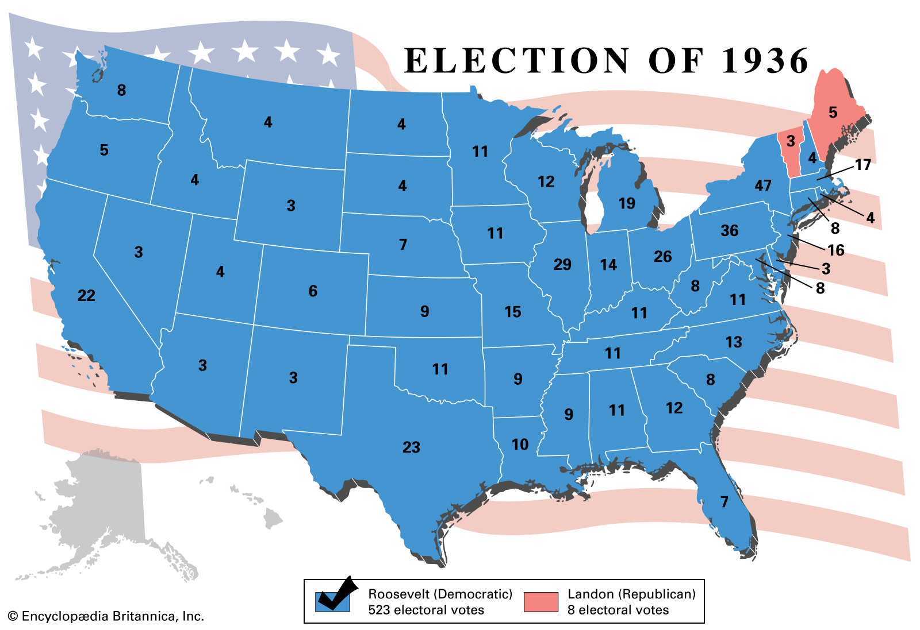
1936 election results
Roosevelt won with 62% of the vote

Slide 29
What went wrong?
Subjects given the questionnaire were chosen from telephone books and clubs, biasing the sample to those with greater wealth
Voting and party preference is correlated with personal wealth…

Slide 30
Volunteer bias
Volunteers for a study may be likely to be different, on average, from the population
For example:
Volunteers for sex studies are more likely to be open about sex
Volunteers for medical studies may be sicker than the general population

Slide 31
Goals of estimation
Accuracy
(on average gets the correct answer)
Precision
(gives a similar answer repeatedly)

Slide 32
Precise
Imprecise
Unbiased
Biased
Each point represents an estimate of a parameter.

Slide 33
Properties of a good sample
Independent selection of individuals
Random selection of individuals
Sufficiently large

Slide 34
In a random sample, each member of a population has an equal and independent chance of being selected.

Slide 35
Independent sampling
The chance of an individual being included in the sample does not depend on who else is sampled.

Slide 36
Non-independent sample

Slide 37
One procedure for random sampling

Slide 38
Population parameters are constants
Estimates are random variables, changing from one random sample to the next from the same population.

Slide 39
Sampling error
The difference between the estimate and average value of the estimate
Larger samples tend to have smaller sampling error and represent the population better

Slide 40
Introduction to R
R is a free, open-source statistical language, used by scientists worldwide.

Slide 41
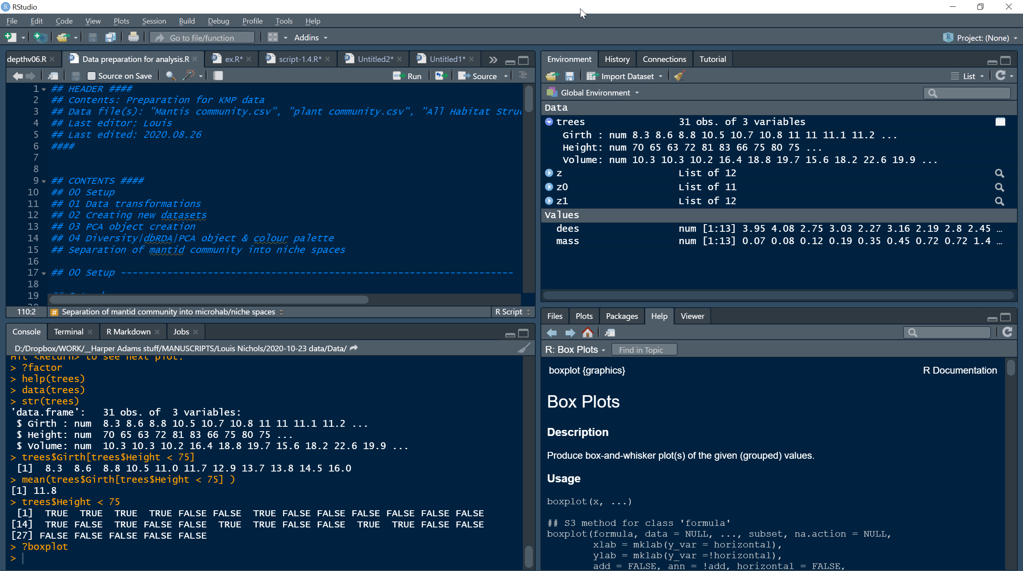

Slide 42
A simple command in R
Prompt
Input
2+2
[1] 4
Output

Slide 43
Basic arithmetic
log(42)
[1] 3.73767
sqrt(4)
[1] 2
4^3
[1] 64

Slide 44
Functions can have multiple inputs
log(4, base = 10) [1] 0.60206

Slide 45
You can define variables
x <- 4
x + 3
[1] 7

Slide 46
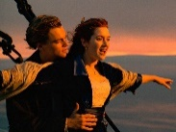
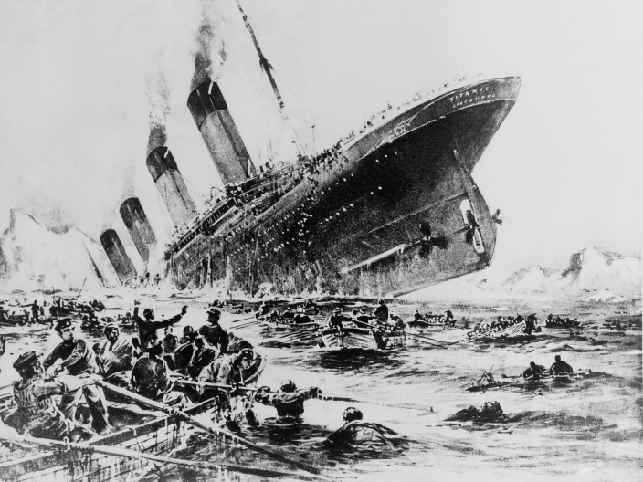
Data frames
data(TitanicSurvival)
head(TitanicSurvival)
Tidy Data:
Each row is an individual
Each column is a variable describing each individual

Slide 47
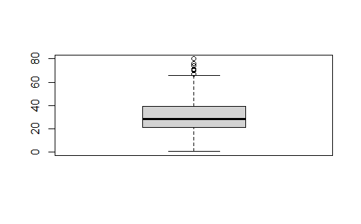
Calculations on data

Slide 48
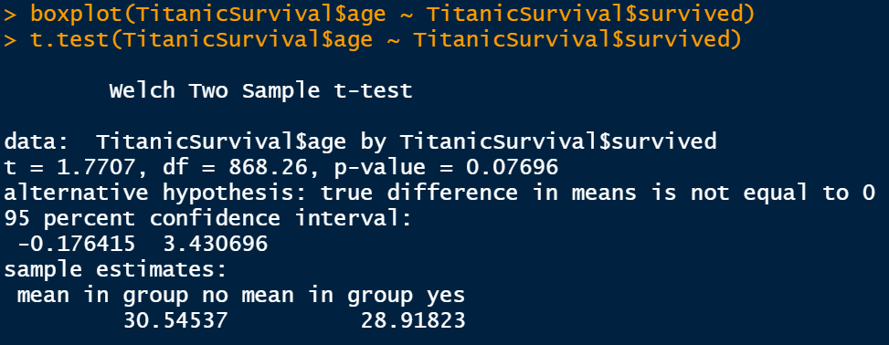
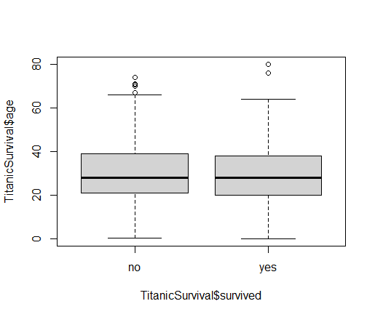
Calculations on data

